Slide 1
Romanticism and Modern Literature
William Blake
A Song of Liberty
March 24, 2025

Slide 2
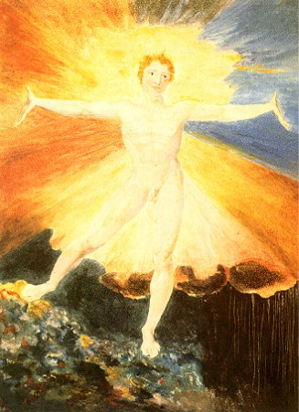
A Song of Liberty
Albion: the primeval man whose fall and division results in the Four Zoas: Urizen, Tharmas, Luvah/Orc, and Urthona/Los. The name derives from the ancient and mythological name of the British Isles

Slide 3
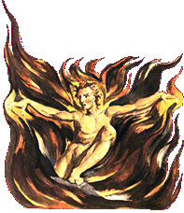
A Song of Liberty
The Eternal Female: Orc; the embodiment of creative passion and energy, and stands opposed to Urizen, the embodiment of tradition.
Orc is described by Blake as 'Lover of Wild Rebellion, and transgressor of God's Law'. He symbolizes the spirit of rebellion and freedom, which provoked the French Revolution.

Slide 4
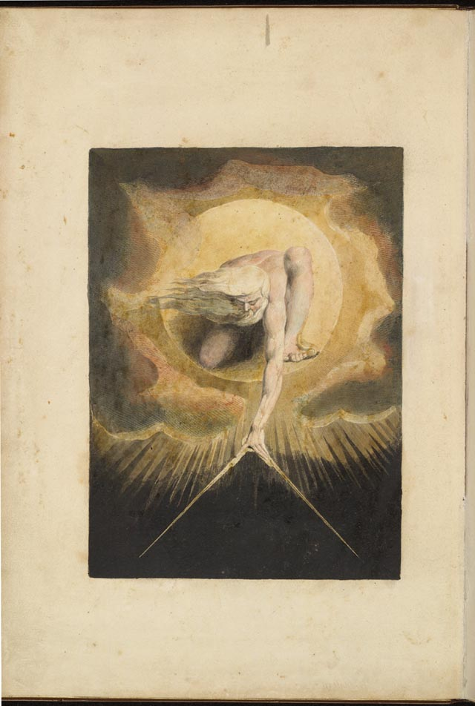
A Song of Liberty
Starry King: Urizen the embodiment of conventional reason and law. He is usually depicted as a bearded old man; he sometimes bears architect's tools, to create and constrain the universe; or nets, with which he ensnares people in webs of law and conventional culture.

Slide 5
A Song of Liberty
Urthona: one of the four Zoas, who were created when Albion, the primordial man, was divided fourfold. Specifically, he is the Zoa of inspiration and creativity. His female counterpart is Enitharmon. Urthona usually appears in his 'fallen' form, that of Los.

